Slide 1
Age of Exploration
Contact and Conflict
1450- 1700
10/16/14

Slide 2
Introduction
Between 1450- 1700 European civilization spread through trade, imperialism, and colonialism
Guiding Questions:
Was this inevitable?
Was the spread of European culture a result of Western Superiority?
10/16/14

Slide 3
Commercial Revolution
Population growth: 70 million in 1500; 90 million in 1600; = more consumers
“price revolution”: Increased food prices, increased volume of money, and the influx of gold & silver
Increased prices meant increase in supply of goods
States and emerging empires sought to increase their economic power
Rise in capitalism (laissez-faire) entrepreneurs; bourgeoisie was at the forefront

Slide 4
Commercial Revolution
The Fuggers in Germany and the Medicis in Italy were among the leading bankers in Europe – funded economic activities
Antwerp became the banking and commercial center of Europe in the 16th century
Chartered companies: state provided monopolies in certain areas (e.g. British East India Co. and the Dutch East India Co.)
Chartered companies became, in effect, a state within a state with large fleets of ships and military power.

Slide 5
Mercantilism
Mercantilism developed in the 17th century
Goal: Nations sought a self-sufficient economy
Strategy: create a favorable balance of trade where one’s country exported far more than it imported.
“Bullionism”: A country should acquire as much gold and silver as possible.
A favorable balance of trade was necessary to keep a country’s supply of gold from flowing to a competing country.

Slide 6
Age of Exploration
“God, glory and gold” were the primary motives
11th and 14th centuries: Christian crusaders caused interest in Asia and Middle East
Rise of nation states = competition for empires and trade

Slide 7
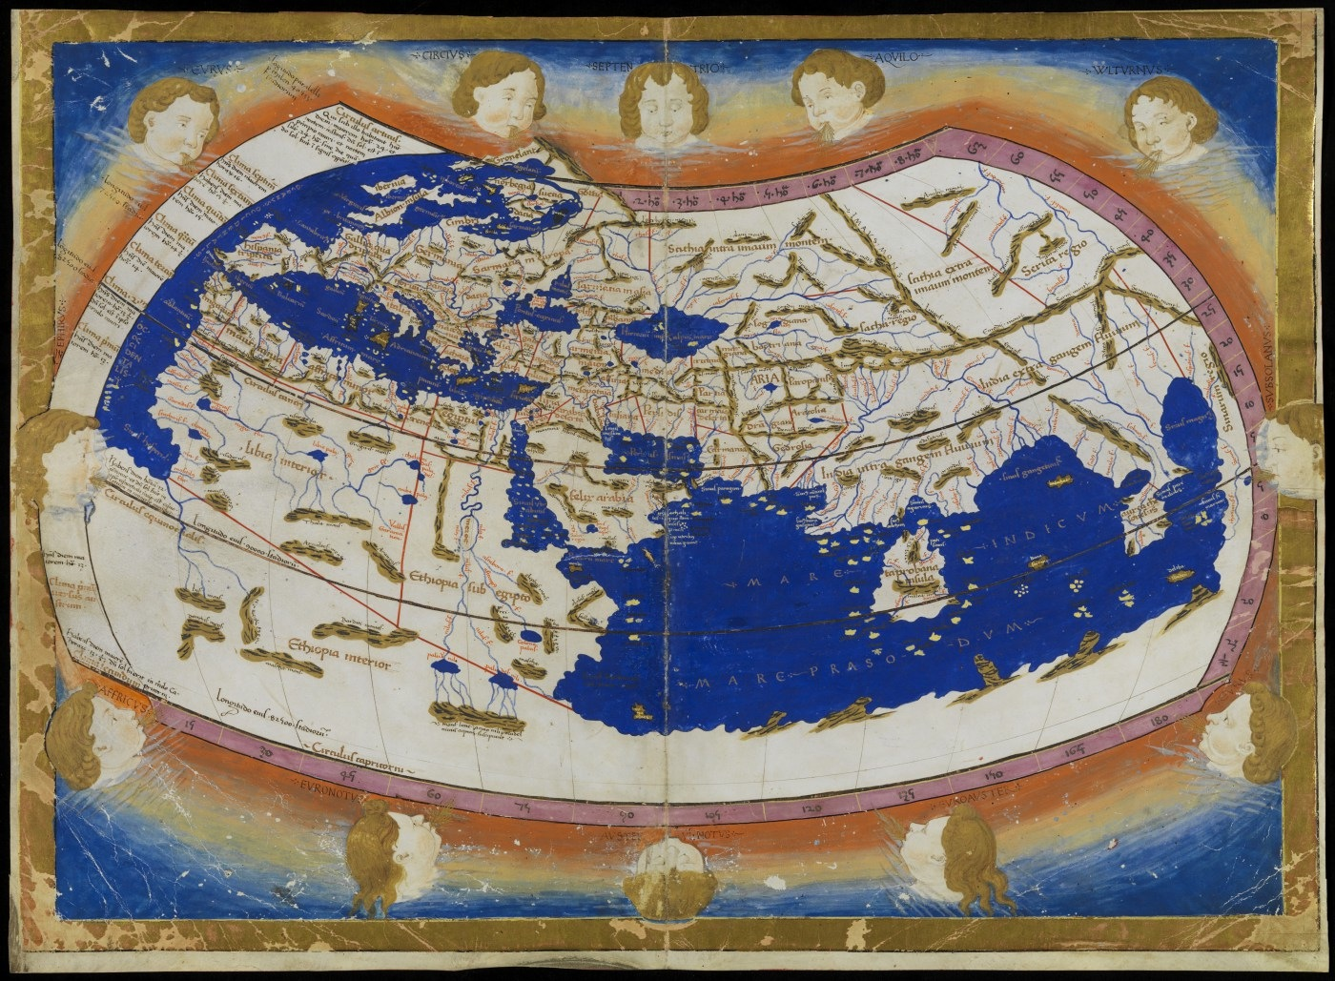
Knowledge (Glory)
Ptolemy portrayed the world as a globe/Global wind patterns/Advancement in astronomy, map making/ ships were built bigger and better
Issues:
Included Europe, Asia and
Libya (Africa), Missing:?
More land than water
No Pacific or Americas
Asia is attached to Africa

Slide 8
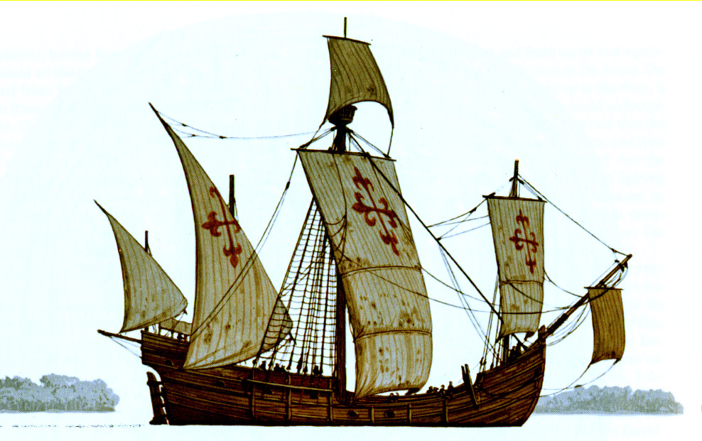
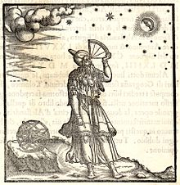
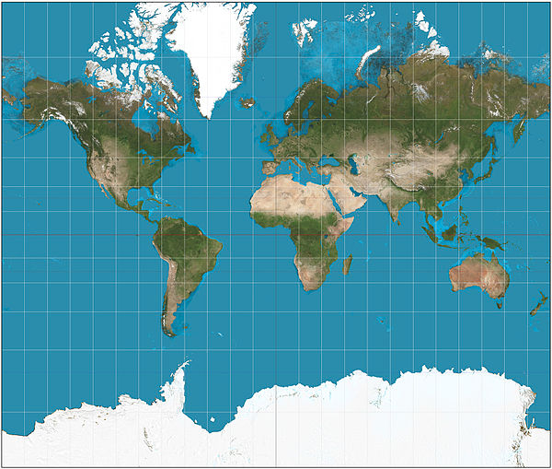
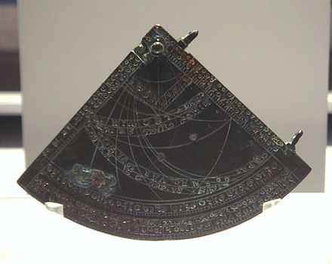
Technology (Glory)
Cartography: Mercator
Projection (1569)
Tools (for latitude)
Caravel Ships – Columbus had
two (Nina and Pinta)
Magnetic Compass
Astrolabe
Quadrant
Notes:
Quadrant: For marine navigation, the earliest examples were found around 1460. They were not graduated in degrees but rather had the latitudes of the most common destinations directly scribed on the limb. When in use, the navigator would sail north or south until the quadrant indicated he was at the destination's latitude, turn in the direction of the destination and sail to the destination maintaining a course of constant latitude. After 1480, more of the instruments were made with limbs graduated in degrees.

Slide 9
SHIP TECHNOLOGY
Portuguese caravel (ca. 1450)
Lighter, faster ships than the Spanish Galleons and much better suited for exploration along the African Coast
Could sail into the wind
Lateen sail and rope riggings
Enabled sails to be quickly and efficiently maneuvered to take advantage of wind power

Slide 10
Capitalism (Gold)
Rise of Capitalism/End of Feudalism
Europe moved from a land based economy to money
After the black death, labour became a valuable commodity
More trade saw the growth of more towns
Growth of middle class – demanded more goods from Asia
We started to rely on capital, labour, raw materials – powerful merchants/monarchy start to sponsor voyages of exploration and colonization

Slide 11
Desire for new markets
Turks (Islamic Empire) had taken over Constantinople in 1453
Turks continued trade with Europe but wanted to control the market. Europeans started to look elsewhere for goods.
Access to Spices Cinnamon, sugar, pepper all came via the spice route
Access to silk via the Silk Road. However, this meant travelling by land through China (expensive and dangerous.)

Slide 12
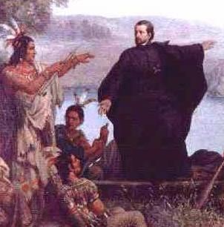
Religion (God)
A place for religious tolerance and a search for new souls – Reformation, Counter Reformation, colonies as home for radicals and heretics
Jesuit missions begin

Slide 13
Portugal (first to seek a route)
Portugal was the leader of European expansion and exploration
Economic/religious motivations
Prince Henry the Navigator sponsored first voyages along the coast of West Africa (1420)
In 1488 Bartholomeu Dias rounded the tip of Africa (the Cape of Good Hope.)
Vasco de Gama went around the Cape and arrived off the Coast of India in 1498.
De Gama establishes Portuguese settlements in Calcut and Goa (brings home spices.)

Slide 14
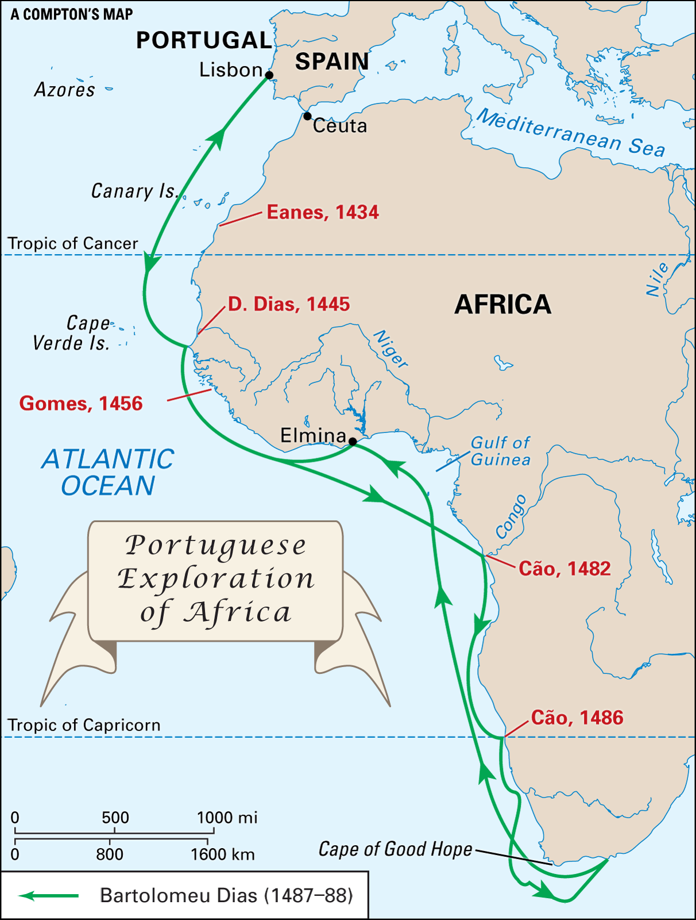

Slide 15
Voyages of Columbus
Columbus was an Italian explorer
Sponsored by Queen Isabella and King Ferdinand of Spain
Reached the Americas in 1492, where he explored Cuba and the island of Hispaniola
Believed he had reached Asia; in three more voyages he attempted to find a route through the major islands of the Caribbean to central Asia

Slide 16
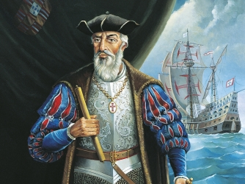
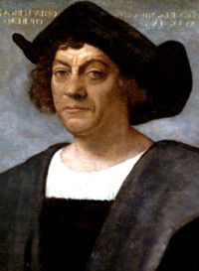
Crash Course History
https://www.youtube.com/watch?v=NjEGncridoQ

Slide 17
Treaty of Tordesillas
Spain and Portugal were both extensively exploring other lands and creating new sea routes for trade.
Both were concerned the other country would attempt to infringe on their newly discovered territories
They agreed on a line of demarcation, an imaginary line that divided the earth into two “spheres of influence”
The treaty of Tordesillas (1494) gave Portugal control of anything east of the line, and Spain control of anything west of the line.
Portugal gained control of everything around Africa while Spain was given the “rights” to most of the Americas

Slide 19
Spain – The Golden Age of Spain
Resembled “New Imperialism” of the late 19th and early 20th
century by outright conquering entire regions and subjugating their
populations
Colonies existed for the benefit of the mother country
Mining of gold and silver was most important (the Crown got 1/5 of all precious metals); accounted for 25% of the crown’s total income
Spain shipped manufactured goods to America and discouraged native
industries from taking root so to avoid competition with Spanish merchants

Slide 20
The Spanish Empire
The Spanish conquerors of the Americas were known as Conquistadors (superior military technology, disease, etc. to overwhelm Indigenous peoples)
Herman Cortes took only three years to overthrow the Aztec Empire of Central Mexico
By 1550, the Spanish had gained control of Northern Mexico
Francisco Pizarro took control of the Incan Empire in the Peruvian Andes
Within 30 years of their arrival the Spanish had taken the western part of Latin America (Mexico, Central and South America) was under Spanish control

Slide 21
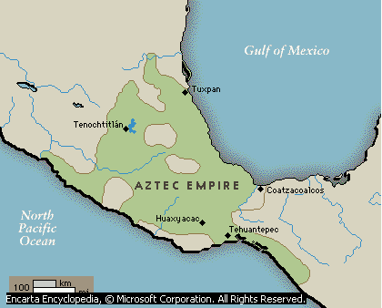
Aztec Empire
The Conquest of the Aztecs and Incas
10/16/14

Slide 22
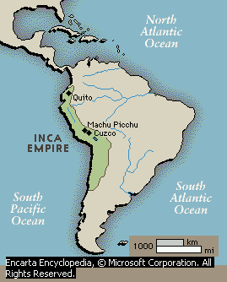
Inca Empire
The Conquest of the Aztecs and Incas
10/16/14

Slide 23
Spanish Conquest
Radical Depopulation
Disease
Forced Labour
Slavery
Demoralization
Introduction of Cattle, Sheep and Goats
The Conquest of the Aztecs and Incas
10/16/14

Slide 24
Dutch Republic (Netherlands)
Dutch East India Company founded in 1602 and became the major force behind Dutch imperialism
Expelled Portuguese from Ceylon (Sri Lanka) and other Spice Islands (Indonesia)
By 1650, began challenging Spain in the New World and controlled much of the American and African trade.

Slide 25
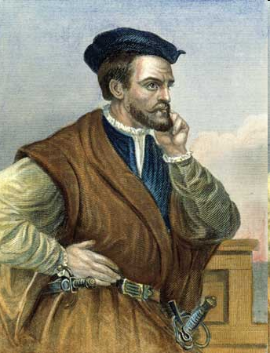
France
Jacques Cartier (1491-1557): In search of the Northwest Passage, he explored the St. Lawrence River region of Canada
Quebec, France’s first settlement in the New World, not founded until 1608.

Slide 26
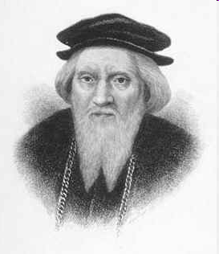
England
Came into exploration relatively late
John Cabot (1425-1500): explored northeast coast of North America; Henry VII not interested in colonization since no gold and silver was found
First permanent settlement not founded until 1607 in Jamestown (Virginia)
Tens of thousands of Englishmen came to the eastern coast of North America in the 17th & 18th centuries
Far more English came to the New World than France, Spain and Portugal

Slide 27
The Slave Trade
Portugal first introduced slavery in Brazil to farm the sugar plantations.
After 1621, Dutch West India Co. transported thousands of slaves to the New World.
England’s Royal African Co. entered the slave trade in the late 17th century
Huge influx of African slaves into Caribbean and North America.
1800, blacks accounted for about 60% of Brazil’s population; about 20% of the U.S. population.
An estimated 50 million Africans died or became slaves during 17th & 18th centuries

Slide 28
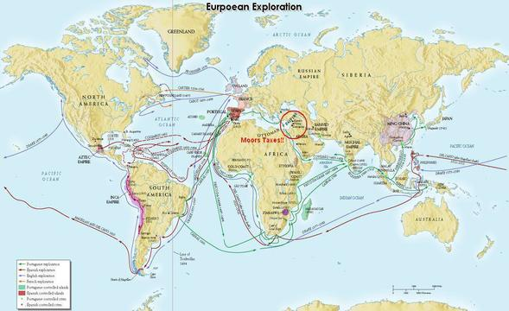
Legacy – Columbian Exchange

Slide 29
Works Cited
Legacy: The West and the World, Garfield Newman
Microsoft Encarta Reference Library 2003
Markville S.S. History, Mark Melnyck
The Conquest of the Aztecs and Incas
10/16/14

